Slide 1


Improving Environmental Sustainability by Reducing ROT and Dark Data
Prepared by: Marwan Al Farah

Slide 2
Table of Content
The Problem
The Solution
Goals and Benefits
Deliverables and Success Criteria
Project Management Strategy
Budget
Project Requirements
Project Proposal Timeline
Conclusion

Slide 3

The Problem
High levels of energy consumption and e-waste in datacenters
Accumulation of ROT and Dark data in the datacenter
Decreased productivity and job quality for staff due to outdated technology
Negative impact on the environment and increased carbon footprint

Slide 4
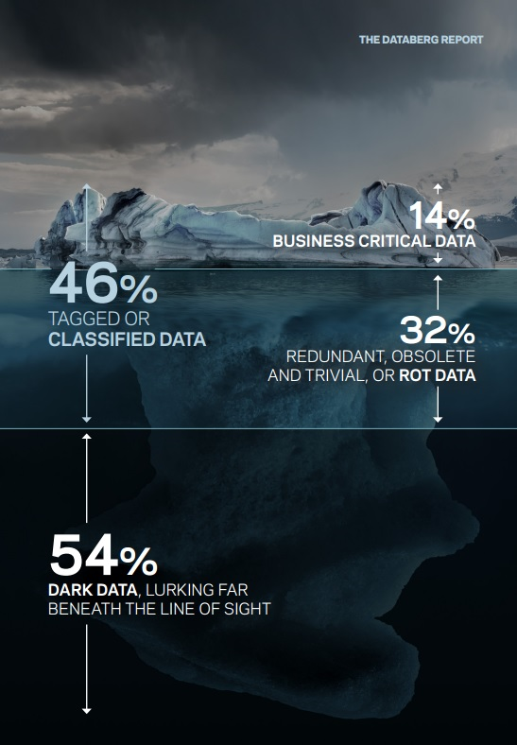
The Problem
According to the Databerg Report:
54% is considered Dark data
46% is tagged or classified data, of which 32% is ROT (Redundant, Obsolete or Trivial) and 14% is business critical data

Slide 5





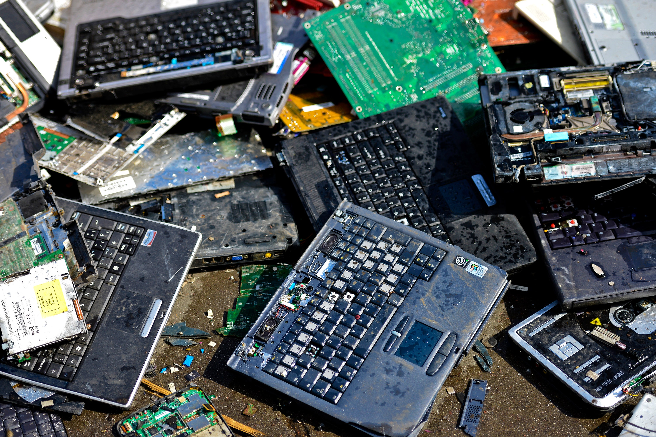
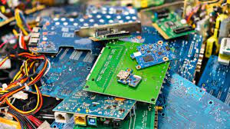

The Solution

Slide 6
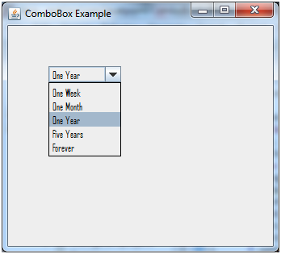

The Solution

Slide 7

Project Goals
Reduce Dark and ROT data
Implement data retention guidelines
Train team on new guidelines
Repair and refurbish servers
Recycle e-waste
Save money
Improve productivity
Improve stakeholder satisfaction
Minimize environmental impact of digital transformation

Slide 8
Project Benefit
Reduce server and storage needs, improve system performance, reduce carbon footprint
Improve data management, improve system performance
Improve team efficiency, improve data management
Reduce need to purchase new servers, extend lifespan of servers
Reduce environmental impact
Increased profits
Increase efficiency
Meet stakeholder expectations and needs
Reduce carbon footprint, reduce e-waste

Slide 9




Project Deliverables
New data retention system
Staff training
Proper disposal of e-waste
Reduced expenses

Slide 10

Project Success Metrics
Decreased percentage of Dark and ROT data
Percentage of data appropriately labeled with retention guidelines
Percentage of team trained on guidelines
Number of servers repaired and refurbished
Weight of e-waste recycled
Total cost savings achieved
Increase in productivity metrics
Increase in stakeholder satisfaction ratings
Reduction in environmental impact metrics

Slide 11
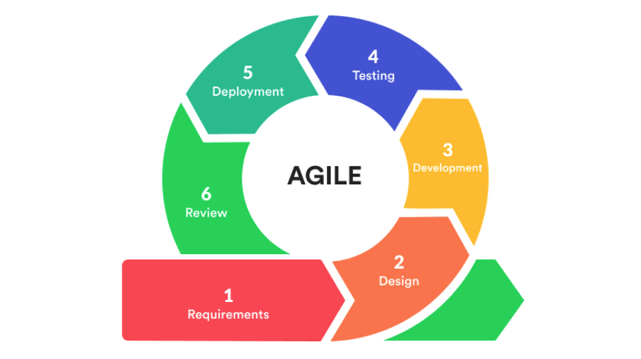
Project Management Strategy
Flexibility
Adapting to changes
Regular Communication with Stakeholders
Incorporate Feedback
Rapid Delivery

Slide 12
Budget
Revenues
Costs
Items | Total Per Year
Minimizing the number of servers bought | 24,000 JOD
Energy saved from minimizing the number of servers (computing power) | 12,000 JOD
Energy saved from the cooling of the datacenter | 6,000 JOD
Total Project Revenue Estimate | 42,000 JOD
Items | Totals
Project Management | 10,000 JOD
Staff Training | 500 JOD
Software | 8,500 JOD
Hardware | 3,000 JOD
Reserves | 3,000 JOD
Total Project Cost Estimate | 25,000 JOD
+ 7,000 Annually

Slide 13
Project Requirements
Ability to scan and categorize all corporate data to find, move, or delete Dark and ROT data.
Enabling the creation of data retention policies that specify the duration for which each piece of data will be needed.
Enabling the refurbishment and repair of servers utilizing contemporary cutting-edge technologies and the recycling of e-waste produced during the refurbishment process.
Training the entire staff on how to use the new data retention guidelines and new system.
Erases the data on its own when the data retention period has passed.

Slide 14
Project Proposal Timeline
Start of Project March 1st
Proposal Approval March 22nd
End of Planning, Start of Execution April 3rd
90% of all staff trained April 10th
Classification of 95% of ROT and Dark data June 5th
Recycling 90% of e-waste & implement retention guidelines July 31st
End of Project
August 31st

Slide 15





Conclusion
Aim: Reduce the negative environmental impact of digital transformation
Solution: Reducing the amount of Dark and ROT data stored in data centers
Methodology: By using the Agile methodology, we will be able to respond quickly to changes and incorporate feedback
Information: Goals, benefits, deliverables, success criteria, project management strategy, budget, and requirements
Result: Increased financial, technical, organizational, environmental value to the organization

Slide 16

Thank You

